Slide 1
Sentiment AnAlysis of costumer reviews

Slide 2
Table of content
Objective
Data Cleaning
Exploratory Data Analysis
Features Extraction
Modeling
Conclusion

Slide 3
OBJECTIVE
We are given the data from the London Hotel Review, which contains one quantitative variable and five qualitative variables, namely Review Rating, Property Name, Review Title, Review Text, Location of the Reviewer, and Date Of the Review respectively.
What we need to do is to Predict the review rating of the Customer based on their Review Text using Sentiment Analysis.

Slide 4
DATA CLEANING
Since our data is taken from different hotels in London, people who visited hotels from another country have used their native language to give a review. Therefore, we first need to convert all text into the English language.
Secondly, some of the rows from the data contain non-alnum data which is of course not useful for us, hence we will remove those rows from the data.
To translate text into English we have used library Translator from google trans

Slide 5
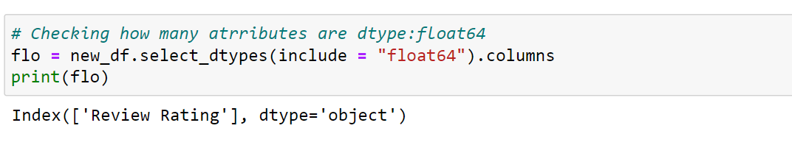
Exploratory data analysis (EDA)
We have only one variable ‘Review Rating’ which is quantitative.

Slide 6
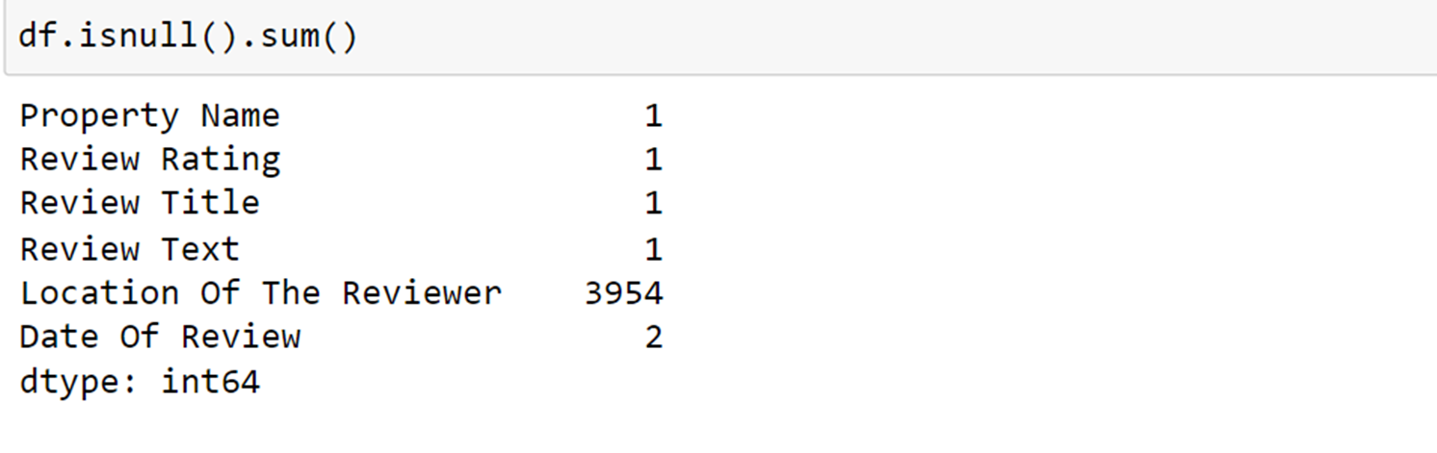
Then, we found that there is one missing value in that column
Since it is the case of multiclass classification we have replaced the missing value by the mode of that class

Slide 7
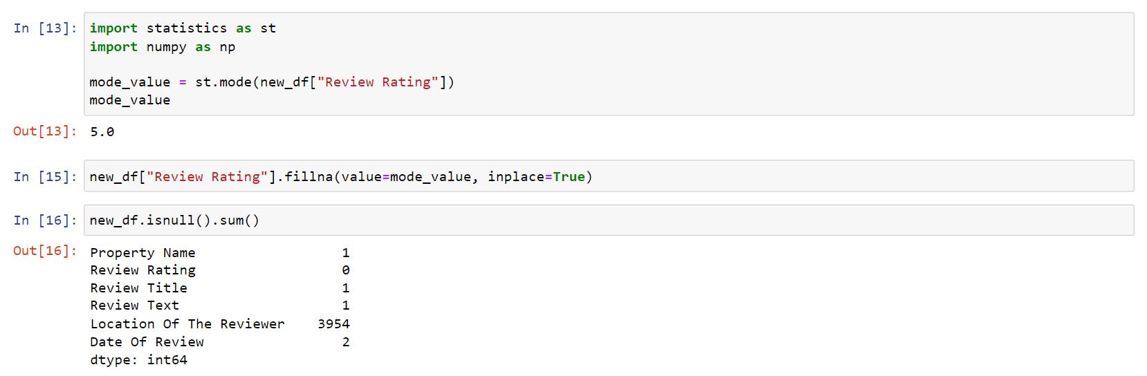
As of now, it shows 0 null values in the column Review Rating.

Slide 8
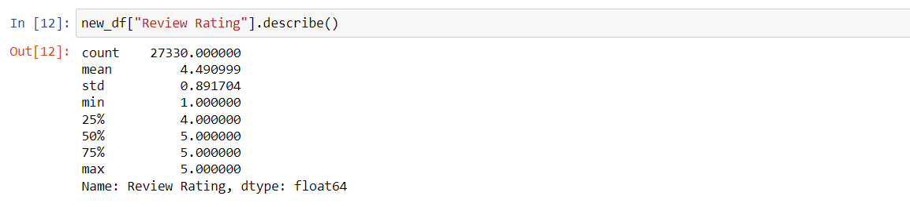
Now, let’s look at the 5-scale summary of the variable Review Title
As we can see, the first quartile is 4.0 implies 75% of ratings are above 4 that is, either 4 or 5
Let us check the frequency of each class in ‘Review Rating’

Slide 9
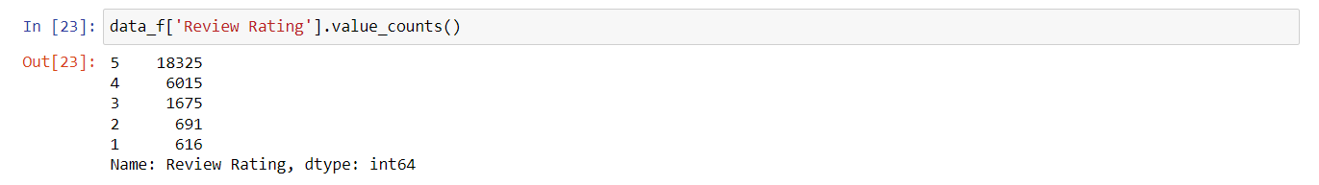
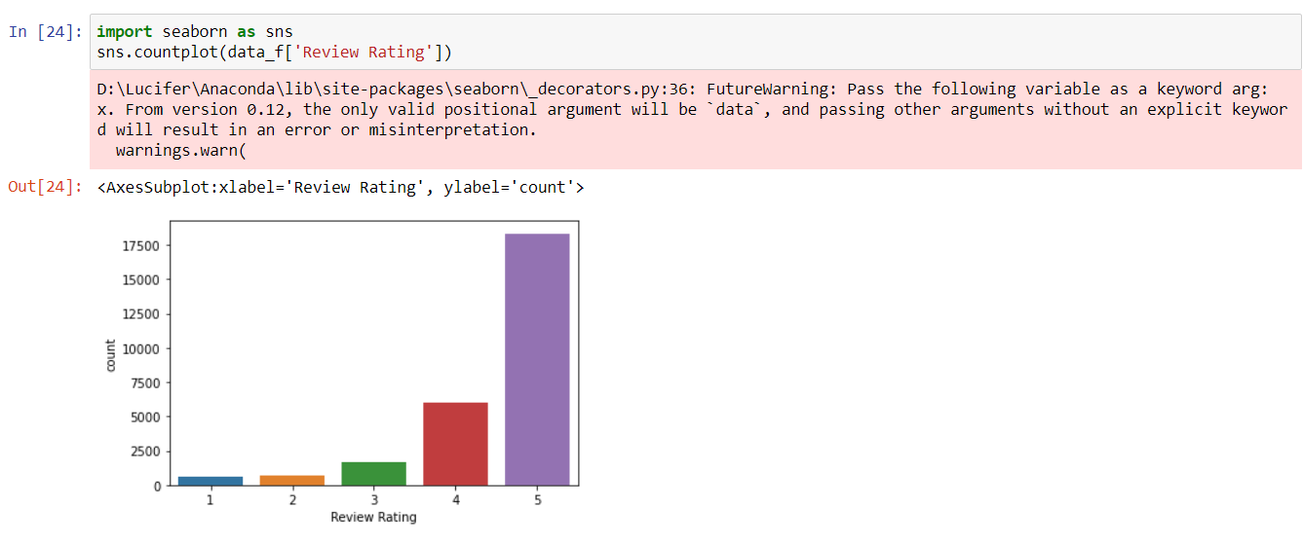
Visually

Slide 10
Features Extraction
Based on the Review Text, firstly we removed stop words from the text using Natural Language Toolkit (NLTK) then we have taken out the positive words, neutral words, and negative words from the text.
Based on the frequency of positive words, neutral words, and negative words in the given review text, we try to predict its review rating.

Slide 11
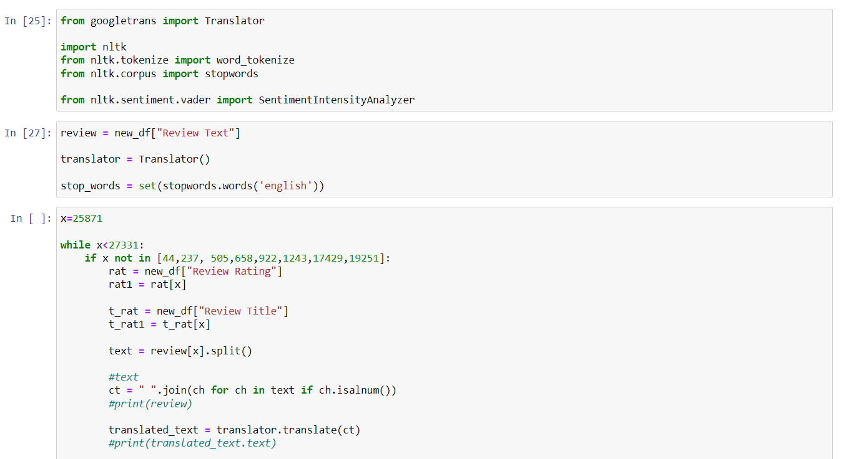

Slide 12
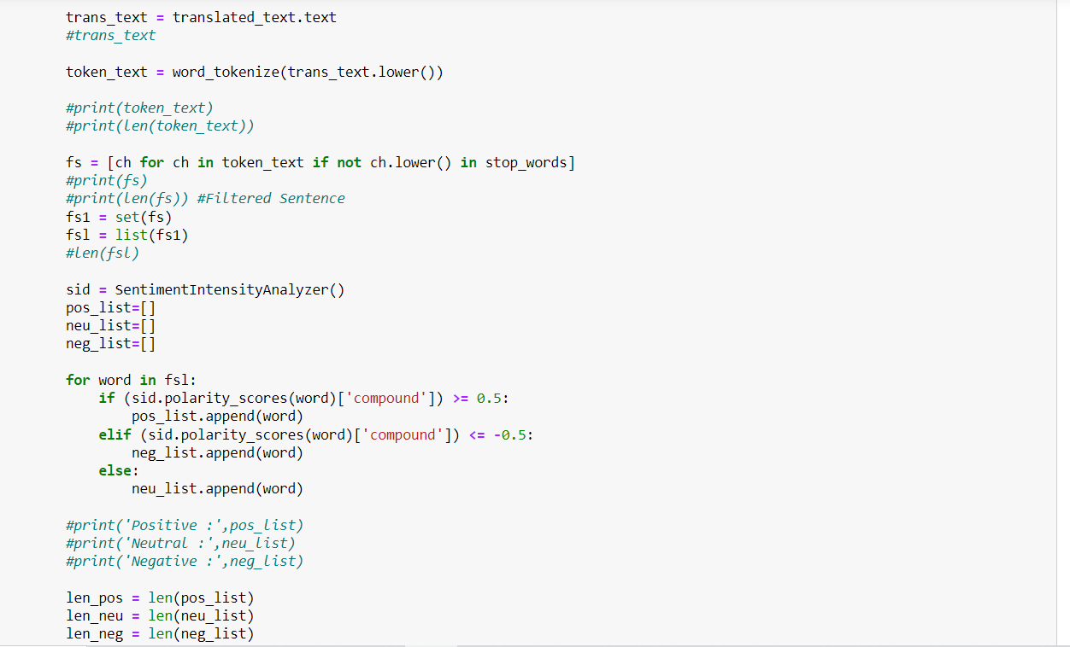

Slide 13
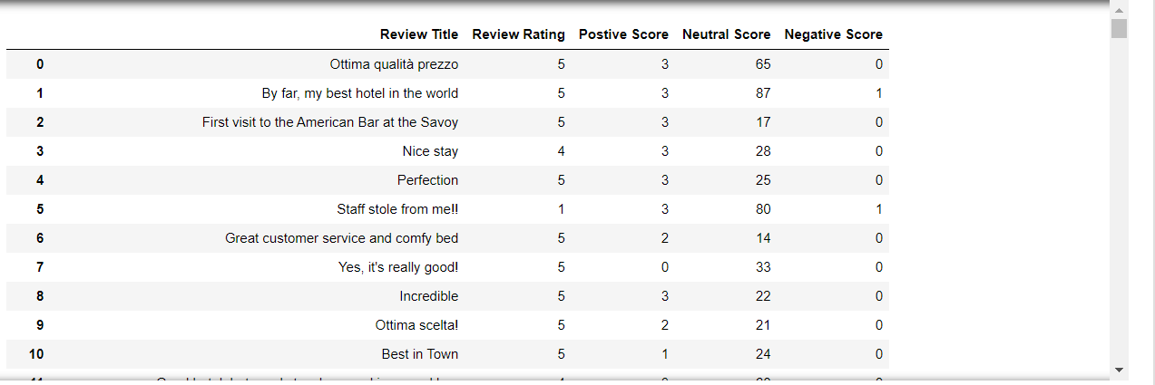
We have created a new table like..

Slide 14
Modeling
Since we are dealing with imbalanced data. So, before performing any modeling technique on the data we will first use the concept of upsampling in order to maintain the balance of the data

Slide 15
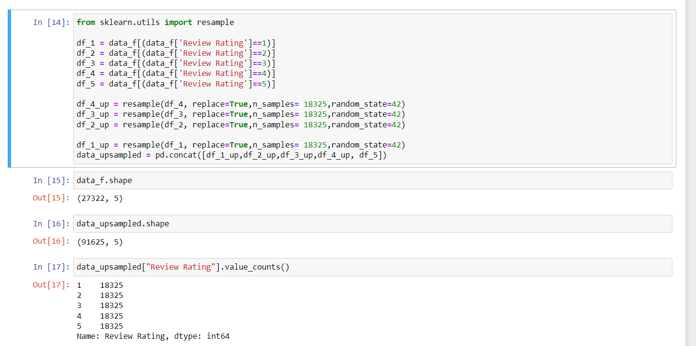
Since we have imbalanced data here. So, we will use the concept of upsampling.

Slide 16
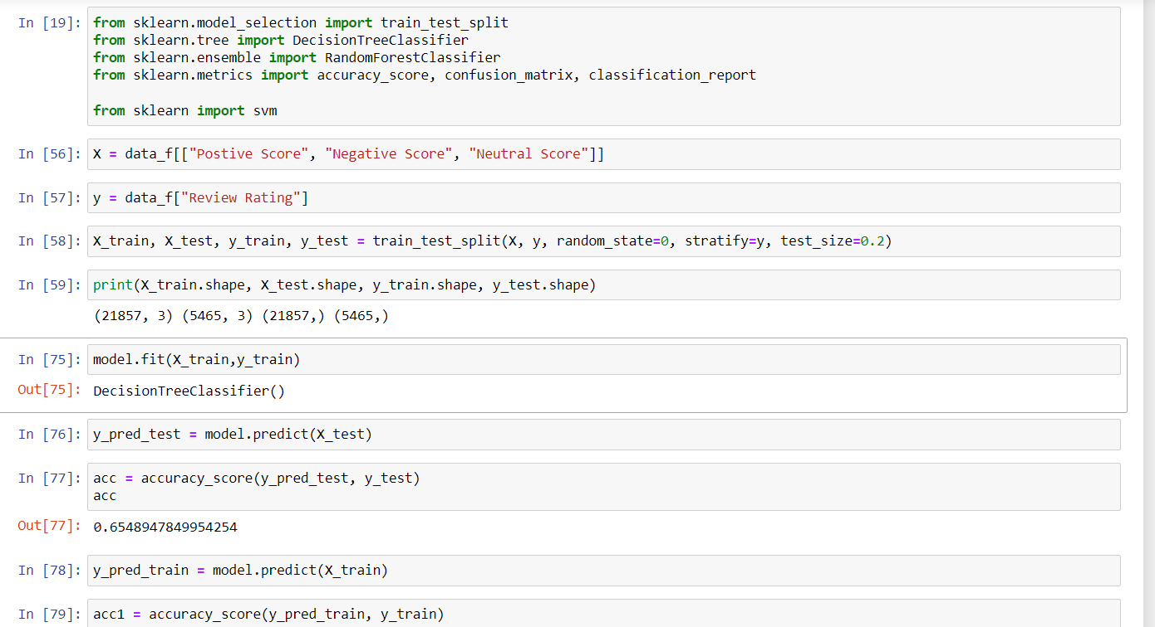
After that we have used DecisionTree algorithm to perform Classification

Slide 17
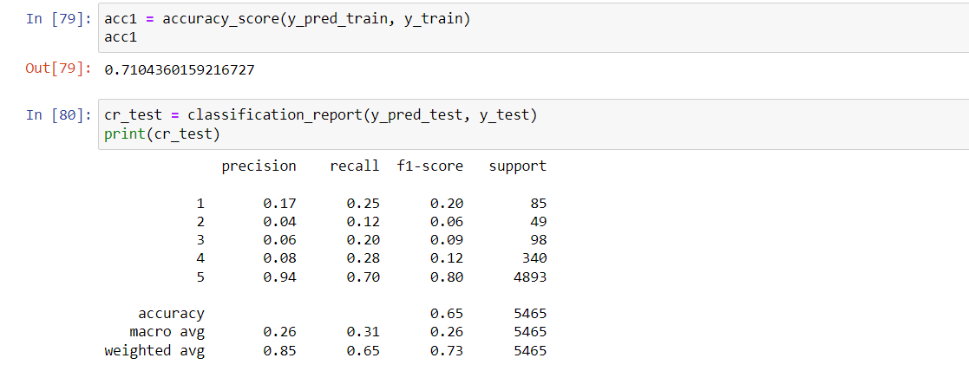

Slide 18
Conclusion
We have got 66% accuracy on testing data and 71% accuracy on the training data
As in the final table we saw that precision for class 1 is 17% and for class 5 is 94%, implying our model can easily capture the good rating but find it difficult to classify class 1. This may be because people who give an almost similar proportion of positive and negative words in their review but give fewer ratings like 1 or 2

